Slide 1





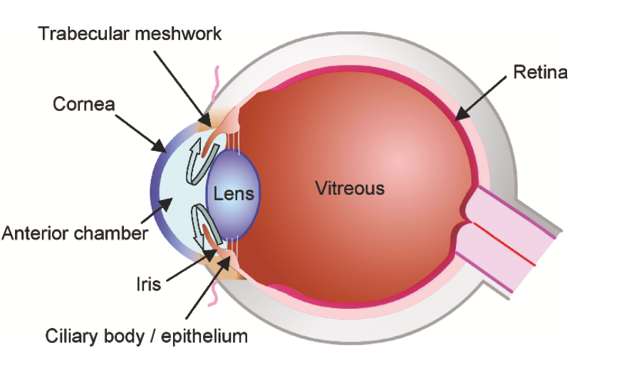
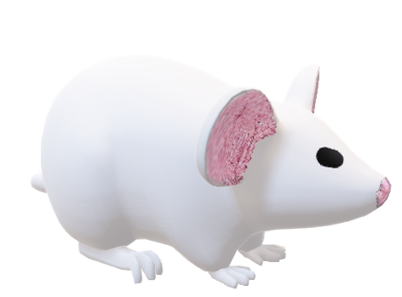

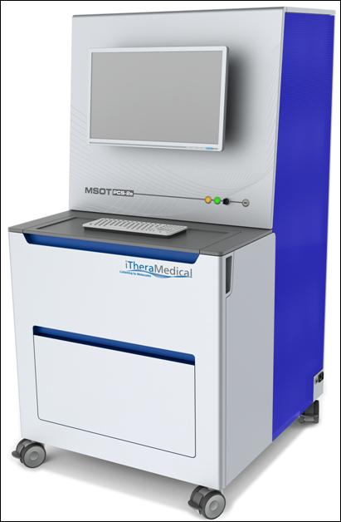
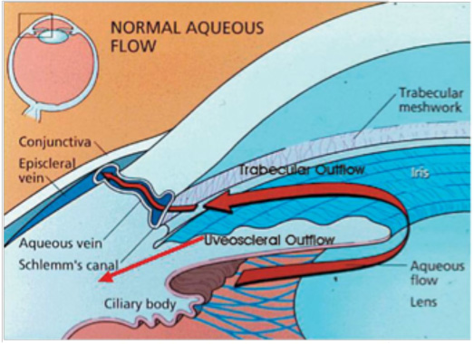
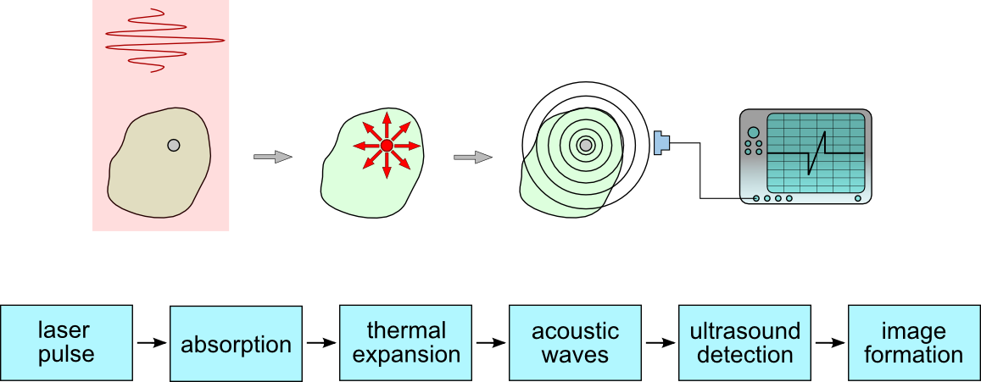



Beta Blockers Reduce Lymphatic Drainage from the Eye: Implications for Glaucoma and Inflammatory Eye Disease
Joseph Hanna, MD, MSc ^{1, 2, 3} ; Yeni H. Yucel, MD, PhD ^{1, 2, 3} ; Xun Zhou, MSc ³; Luz Paczka-Georgi BSc³; Neeru Gupta, MD, PhD, MBA ^{1, 2, 3}
1. Department of Ophthalmology and Vision Sciences, University of Toronto, Toronto, ON, Canada.
2. Department of Laboratory Medicine and Pathobiology, University of Toronto, Toronto, ON, Canada.
3. Keenan Research Centre for Biomedical Science, St. Michael's Hospital, Toronto, ON, Canada.
Introduction
Work Flow:
Timolol Lymph Node Imaging
Betaxolol Lymph Node Imaging
Right Eye Injection
Glaucoma is a leading cause of irreversible blindness worldwide ¹
Increased intraocular pressure (IOP) is a major risk factor for glaucoma ²
IOP increases due to the imbalance between inflow and outflow of aqueous humor ³
Aqueous drains through the conventional and uveoscleral pathways
We have previously described lymphatic drainage from the eye ^{4,5}
There is evidence in other systems that beta-blockers reduce lymphatic function ⁶
1µL of 1mM QC-1/BSA tracer
ViewMSOT Software (iThera Medical)
Photoacoustic Imaging
Visualization:
Adaptive Matched Filter (AMF)
20 min, 2hrs and 4hrs post injection
WLs (nm)
680
695
735
755
775
795
825
885
925
955
980
Reconstruct Images: Backprojection
Ocular Transporters in Ophthalmic Diseases
Pre-injection PAI
Quantification:
Linear Regression
CD-1 Albino mice (n=9)
Statistical Analysis
MSOT inVision 128, iThera Medical, Munich, Germany
Mean Pixel Intensity (MPI) for timolol and control eyes and LNs
Logged MPI = ln(MPI+100)
Slope = change in Logged MPI over time
AUC= Area Under the Curve
Linear mixed model comparing timolol and control slopes and AUC
Results
Timolol reduced the lymphatic drainage from the eye to cervical lymph node. Arrows indicate signal in the right lymph node (Scale bar 5mm;
Betaxolol reduced lymphatic drainage from the eye to cervical lymph node. Arrows indicate signal in the right lymph node (Scale bar 5mm; Asterisks indicate right cervical lymph node; S, I, R and L indicate superior, inferior, right and left, respectively)
Intraocular Pressure (IOP)
Timolol Lymph Node Signal Quantification
Medical Surgical Nursing Care, 3rd Edition
Beta-adrenergic blockers are commonly used glaucoma medication and the including timolol, a non-selective ß-adrenergic blocker and betaxolol, a selective ß₁-adrenergic blocker ⁷
No studies examined their effects on ocular lymphatic drainage
Basline IOP showed no significant difference between all mice groups
Before injection IOP was significantly decreased in timolol group compared with controls (12.62 ± 1.99 mmHg vs 15.80 ± 0.84 mmHg, respectively; P = 0.007), and also significantly decreased in the betaxolol group compared with controls (14.0 ± 1.0 mmHg vs. 18.0 ± 0.5 mmHg, respectively; P < 0.0001)
Betaxolol Lymph Node Signal Quantification
Purpose
Photoacoustic Cervical Lymph Node Imaging
To study the acute effect of timolol, a non selective ß-adrenergic blocker, and betaxolol, a selective ß₁-adrenergic blocker, on lymphatic drainage from the eye
Timolol
Timolol Photoacoustic Eye Imaging
(A) Mean area under the curve (AUC) was significantly reduced in the timolol group compared with controls(20.7 ± 5.4 vs. 17.2 ± 1.8, respectively; P = 0.13) (B) Photoacoustic mean pixel intensity signal (arbitrary unit (a.u.)) in the right cervical lymph nodes overtime
Materials and Methods
Photoacoustic imaging:
Mice:
Wildtype CD1 mice (n=26; 10-12 weeks; mixed gender)
Treatment:
Mice were treated with either topical timolol, a non-selective ß-blocker, 0.5% (n=8), or topical betaxolol 0.5% , a selective ß₁-adrenergic blocker, (n= 6) twice daily for 13 days and compared to respective controls groups (n=5 and n=7; GenTeal Artificial Tears)
A final dose of treatment was instilled at 9 am on day 14
Intraocular Pressure (IOP):
IOP was measured by rebound tonometry at baseline and before injection (TonoLab, Icare, Finland)
In vivo Imaging:
Photoacoustic imaging MSOT InVision 128 (iThera Medical, Germany)
Under 2% isoflurane general anesthesia, 1 hour after the last dose, near infrared QC1- quencher dye (1µl; 1 mM; LI-COR, USA) conjugated to Bovine Serum Albumin (QC-1/BSA) was injected in the anterior chamber
Under 1.5% isoflurane general anesthesia, in vivo cross-sectional photoacoustic MSOT imaging of the head and neck region was performed
Betaxolol
(A) Mean AUC was significantly reduced in the betaxolol group compared with controls (4.5 ± 2.6 vs. 9 ± 1.7, respectively; P = 0.004). (B) Photoacoustic mean pixel intensity signal (arbitrary unit (a.u.)) in the right cervical lymph nodes overtime
Betaxolol Photoacoustic Eye Imaging
Conclusions
Topical treatment with beta blockers reduced lymphatic clearance from the eye by action on at least the beta 1 receptor
This finding has implications for the treatment of secondary glaucomas and inflammatory eye disease in which clearing proteins and antigen from the eye is important to disease recovery and sight protection.
*
*
*
Timolol reduced the decay of infrared tracer signal from the eye. Arrows indicate signal in the right eye (Scale bar 5mm; Asterisks indicate the right eye; S, I, R and L indicates superior, inferior, right and left, respectively)
Commercial Conflicts- none
References
Timolol Eye Signal Quantification
1. Tham Y-C, Li X, Wong TY, Quigley HA, Aung T, Cheng C-Y. Global prevalence of glaucoma and projections of glaucoma burden through 2040: a systematic review and meta-analysis. Ophthalmology. 2014 Nov;121(11):2081–90.
2. Wilson M. Intraocular Pressure: Does it Measure Up? The Open Ophthalmology Journal. 2009;3(1):32-37. doi:10.2174/1874364100903010032.
3. Primary Open-Angle Glaucoma. N Engl J Med. Massachusetts Medical Society; 2009 Jun 18;360(25):2679–80.
4. Yücel YH, Johnston MG, Ly T, et al. Identification of lymphatics in the ciliary body of the human eye: a novel “uveolymphatic” outflow pathway. Exp Eye Res. 2009;89(5):810-819. doi:10.1016/j.exer.2009.08.010.
5. Yücel YH, Cardinell K, Khattak K, et al. Fluid Drainage from the Eye to Lymph Nodes Measured by Noninvasive Photoacoustic Imaging of Near Infrared Nanoparticles. IOVS In Press
6. Le CP, Nowell CJ, Kim-Fuchs C, Botteri E, Hiller JG, Ismail H, et al. Chronic stress in mice remodels lymph vasculature to promote tumour cell dissemination. Nat Commun. Nature Publishing Group; 2016 Mar 1;7:10634.
7. Marquis RE, Whitson JT. Management of glaucoma: focus on pharmacological therapy. Drugs Aging 2005; 22(1): 1–21.
Betaxolol Eye signal Quantification
Acknowledgments:
Henry Farrugia Research Fund
Thor and Nicky Eaton Research Fund
(A) Mean AUC was significantly increased in the timolol group compared with controls (19.6 ± 4.5 vs 13.2 ± 4.2, respectively; P = 0.026) (B) Photoacoustic mean pixel intensity signal (arbitrary unit (a.u.)) in the right cervical lymph nodes overtime
(A) Mean AUC of betaxolol-treated mice showed no significant difference to controls (20.7 ± 5.4 vs. 17.2 ± 1.8, respectively; P = 0.13) (B) Photoacoustic mean pixel intensity signal (arbitrary unit (a.u.)) in the right cervical lymph nodes overtime
Glaucoma Research Society of Canada
Injection
Pre-scan 20 min 2h 4h
Ontario Graduate Scholarship

