Slide 1
Combined Versus Sequential Phacoemulsification and Pars Plana Vitrectomy: A Meta-Analysis
Marko M. Popovic MD, MPH(C),¹ Armin Farahvash MD(C),² Arshia Eshtiaghi MD(C),² Peter J. Kertes MD CM, FRCSC,^{1,3} Rajeev H. Muni MD, MSc, FRCSC^{1,4}
¹ Department of Ophthalmology and Vision Sciences, University of Toronto, Toronto, Ontario, Canada
² Faculty of Medicine, University of Toronto, Toronto, Ontario, Canada
³ John and Liz Tory Eye Centre, Sunnybrook Health Sciences Centre, Toronto, Ontario, Canada
⁴ Department of Ophthalmology, St. Michael’s Hospital/Unity Health Toronto, Toronto, Ontario, Canada

Slide 2
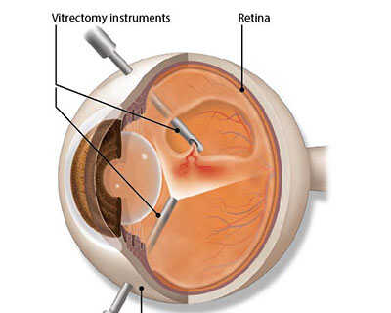
Introduction
Pars Plana Vitrectomy
Many phakic patients require cataract surgery following pars plana vitrectomy (PPV)
Combined phacoemulsification and PPV (phaco-PPV) may reduce recovery time, cost, and use of anesthesia
Aim: To compare the differences in efficacy and incidence of complications between combined and sequential phaco-PPV
AAO.org
Phacoemulsification
Porela-Tiihonen et al. 2016
Notes:
Pars plana vitrectomy (PPV) is indicated for various conditions: retinal detachment, vitreous hemorrhage, macular hole, and epiretinal membrane.
There is a high rate of phakic patients requiring subsequent cataract surgery following PPV
Combined phacoemulsification and PPV (phaco-PPV) reduces recovery time, cost, and use of anesthesia
No difference in success between combined and sequential phaco-PPV, but inconsistencies in reported complications
Aim: To compare the differences in efficacy and incidence of complications between combined and sequential phaco-PPV

Slide 3
Methods
Databases: Ovid MEDLINE, EMBASE and Cochrane CENTRAL
Studies that compared combined versus sequential phaco-PPV head-to-head
Primary outcome: postoperative best corrected visual acuity (BCVA)
Secondary outcome: postoperative complications
Meta-analysis was conducted using a random effects model in all cases
Notes:
Databases: Ovid MEDLINE, EMBASE and Cochrane CENTRAL
Studies that compared combined versus sequential phaco-PPV head-to-head
Primary outcome: Postoperative best corrected visual acuity (BCVA)
Secondary outcomes: Efficacy outcomes like incidence of myopia, and postoperative complications
Meta-analysis was conducted using a random effects model in all cases
Risk of bias assessment: Cochrane risk of bias assessment tool for randomized trials and the ROBINS-I tool for observational studies

Slide 4
Results- Study Screening
Records identified through database searching (n = 5410)
Records after duplicates removed (n = 4228)
Records screened (n = 4228)
Records excluded (n = 4192)
Full-text articles assessed for eligibility (n = 36)
Full-text articles excluded, with reasons (n = 21)
Retained lens fragment indication (n = 4)
No analysis between groups (n = 4)
No combined surgery group (n = 4)
No sequential surgery group (n = 4)
No cataract surgery (n = 2)
No reported clinical outcomes (n = 2)
Follow-up study of the same patients (n = 1)
Studies included in qualitative synthesis (n = 15)

Slide 5
Results- Baseline Data
1 RCT and 14 comparative studies
Baseline Data | Mean±SD |  | Mean Follow-up (months) |  | Number of eyes (studies)
 | Combined surgery | Sequential surgery | Combined surgery | Sequential surgery
Number of eyes | 1407 | 951 | 11.4 | 14.7 | 2358 (15)
Age | 62.5±11 | 62.1±11 | 11.4 | 14.7 | 2249 (14)
% Male | 42.6 | 45.1 | 11.4 | 14.7 | 2217 (14)
Mean BCVA | 0.92±0.63 | 0.79±0.46 | 7 | 10.4 | 752 (5)
Mean IOP | 12.1±3.1 | 12.5±3.7 | 13.4 | 13.7 | 115 (2)

Slide 6
Results- Efficacy Outcomes
Mean BCVA
Mean Absolute Error
Outcome | Mean (SD) |  | Mean Follow-up (months) |  | Number of eyes (studies) | P-value
 | Combined surgery | Sequential surgery | Combined surgery | Sequential surgery
Mean BCVA | 0.52±0.61 | 0.39±0.44 | 8.23 | 17 | 863 (7) | 0.76
Mean absolute error | -0.31±0.94 | -0.14±0.74 | 13.1 | 13 | 121 (2) | 0.46
Incidence of myopia | 65.3% | 41.3% | 4.67 | 6.13 | 167 (2) | 0.44
MH non-closure/re-opening | 1.09% | 13.4% | 14.04 | 25.3 | 234 (2) | 0.04
Pre-Prediction error | 0.56 | 0.45 | 4.67 | 6.13 | 167 (2) | 0.06
Incidence of Myopia
MH Non-closure/Re-opening
Pre-Prediction Error

Slide 7
Results- Complications
Synechiae Formation
Outcomes | Mean (SD) |  | Mean Follow-up (months) |  | No. of eyes (studies) | P-value
 | Combined surgery | Sequential surgery | Combined surgery | Sequential surgery
Hyphema | 0.074 | 0.049 | 11.4 | 11.4 | 245 (2) | 0.36
Iris trauma | 0.0091 | 0.021 | 10.7 | 13.5 | 1199 (2) | 0.1
Synechiae formation | 0.18 | 0.065 | 16.3 | 15.3 | 120 (3) | <0.001
Fibrin formation | 0.14 | 0.048 | 15.7 | 15 | 1231 (6) | <0.001
IOL dislocation | 0.024 | 0.008 | 10.7 | 13.5 | 1360 (3) | 0.26
Macrophage opacification on IOL | 0.036 | 0.013 | 21.9 | 19.5 | 213 (2) | 0.35
Posterior Capsular Opacification | 0.12 | 0.074 | 15.6 | 14.9 | 1212 (5) | 0.64
Posterior Capsular Tear | 0.029 | 0.053 | 11 | 13.4 | 1634 (6) | 0.002
Endophthalmitis | 0.0047 | 0.0062 | 15.5 | 14.6 | 1115 (3) | 0.68
Final IOP | 22.6 (9.4) | 19.7 (7.6) | 21.9 | 19.5 | 111 (2) | 0.09
Incidence of high IOP | 0.18 | 0.094 | 15.8 | 15 | 1190 (5) | 0.36
Glaucoma | 0.093 | 0.029 | 14.4 | 14.9 | 177 (3) | 0.66
Intraoperative or postoperative RD | 0.031 | 0.0088 | 14.3 | 13.9 | 1312 (6) | 0.03
Vitreous hemorrhage | 0.053 | 0.037 | 12.4 | 12.5 | 299 (3) | 0.61
Retinal tear | 0.056 | 0.15 | 14.9 | 14.4 | 172 (2) | 0.06
Cystoid Macular Edema | 0.024 | 0.056 | 13.9 | 21.4 | 422 (5) | 0.72
Fibrin Formation
Retinal Detachment
Posterior Capsular Tear

Slide 8
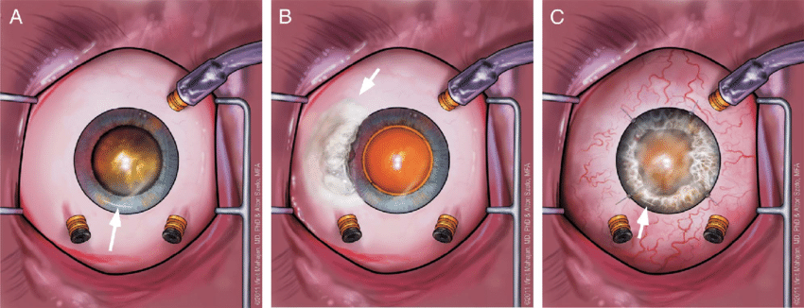
Results – Subgroup Analysis
1. Which surgery was conducted first in sequential surgery
2. Surgical indication
The results of both analyses did not differ from the main conclusions

Slide 9
Discussion
Synechiae and fibrin formation: longer operation time, lack of red reflex and difficulty of circular capsulorhexis with combined surgery
Retinal detachment: higher degree of surgical manipulation or more aggressive peripheral vitreous shave in combined surgery
Posterior capsular tear: previous vitrectomy can make the posterior capsule mobile and may weaken the support of the zonules
Macular hole non-closure/reopening: only 2 studies included, internal limiting membrane might not have been peeled in one study
Notes:
Limitations:
Challenging to conduct subgroup analysis as reported data was limited
Differences in surgical centres, resources, surgeons, follow-up duration, and method of outcome assessment were variable across studies

Slide 10
Conclusions
No difference in postoperative BCVA and refractive outcomes between combined and sequential phaco-PPV
Complications: While in the combined surgery group the risks of synechiae formation, fibrin formation, and retinal detachment were higher, the risks of posterior capsular tear and macular hole non-closure were lower
Given the variability in outcome reporting and associated heterogeneity, future randomized controlled trials are needed

Slide 11
Questions?
Email: marko.popovic@mail.utoronto.ca

