Slide 1
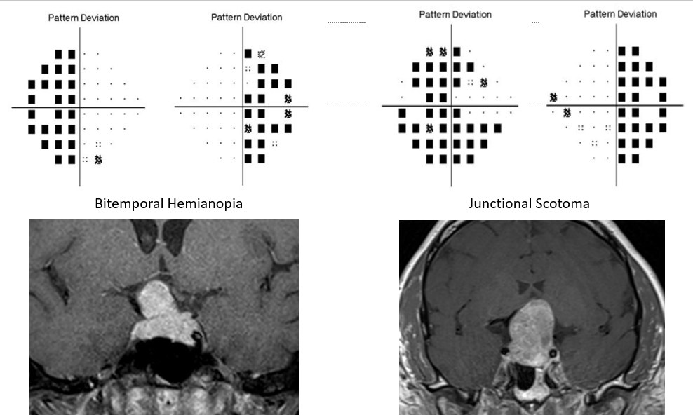
Junctional Scotoma and Patterns of Visual Field Defects Produced by Lesions Involving the Optic Chiasm
Laura Donaldson, MD, PhD¹, Arshia Eshtiaghi, BSc², Simone Sacco, MD³, Jonathan Micieli, MD^{1,}, Edward Margolin , MD^{1,4} ¹Department of Ophthalmology and Vision Sciences, University of Toronto, Toronto, Canada ²Faculty of Medicine, University of Toronto ³Department of Medical Imaging, University of Toronto, Toronto, Canada ⁴Department of Medicine, Division of Neurology, University of Toronto, Toronto, Canada
Abstract
Background: Lesions of the optic chiasm (OC) typically produce bitemporal hemianopia (BTH) on visual field (VF) testing while lesions located at the nasal optic nerve-chiasmal (ON-OC) junction have been proposed to produce junctional scotoma (JXS), a central defect in the ipsilateral eye with temporal field loss in the contralateral eye. In this study we investigated whether the pattern of VF loss in patients with chiasmal compression predicted the appearance of the causative lesion on neuroimaging and described the clinical presentation of these patients with different types of VF defect.
Methods: Retrospective chart review of patients seen in tertiary neuro-ophthalmology practice over 6 consecutive years with lesions abutting or displacing the OC was performed. Lesion size and location relative to the OC on neuroimaging was determined and correlated with VF defects as well as ocular coherence topography (OCT) of the peripapillary retinal nerve fibre layer (RNFL) and macular ganglion cell complex (GCC).
Results: 53 patients were enrolled. VFs demonstrated JXS (n=18), BTH (n=14), monocular VF defect (n=4), and no VF defect (n=17). 64.7% of cases with normal VFs had radiologic OC compression. Lesion volume was highest in the JXS group, these patients also had the poorest presenting visual acuity. All patients with JXS showed involvement of the ON-OC junction, however not all cases showed compression of the OC from the nasal direction (15/18) and 17/18 also showed compression of one or both prechiasmatic ONs. Compression of the ON-OC junction was also seen in 79% of BTH, 100% of monocular VF defect and 59% of no VF defect cases. 50% of patients with normal VFs already had thinning of the GCC on OCT. GCC thinning was most pronounced nasally in the BTH group but diffuse bilateral thinning was found in 38% of cases compared with 60% of JXS. VFs improved in 6/6 patients with BTH but only 5/8 JXS cases after treatment.
Conclusions: JXS is more often seen with larger lesions and when there is compression of both the prechiasmatic ON and ON-OC junction. These patients have worse presenting visual acuity and poorer outcomes. Not all patients with radiologic compression had VF defects, though 50% of patients with normal VFs had evidence of compression on the macular GCC analysis, emphasizing the importance of macular OCT in the evaluation of patients with lesions involving the OC.
Introduction
Classic teaching states that compression of the OC impacts decussating nasal retinal axons producing a bitemporal hemianopia (BTH) (1). In fact, visual field (VF) defects resulting from chiasmal lesions are highly variable and complete BTH is uncommon (2,3).
One large series of patients with chiasmal lesions found BTH in 11% and anterior junction syndrome in 13% (4). Anterior junction syndrome, also known as junctional scotoma (JXS), refers to a specific pattern of VF loss: central defect in one eye with temporal defect, usually superiorly, in the fellow eye. This has been postulated to occur as a result of compression of the optic nerve (ON)-OC junction where crossing nasal axons were proposed to make a short anterolateral detour into ON of contralateral eye forming a structure which was termed Wilbrand’s knee (5). JXS has been reported to occur in patients with pituitary macroadenoma as well as other parasellar compressive lesions and inflammatory optic neuropathies (6-9).
Figure 1. Bitemporal hemianopia (left ) and junctional scotoma (right) caused by parasellar lesions
Methods
Retrospective chart review of patients seen in tertiary neuro-ophthalmology clinics between January 2014 and November 2020. 53 patients with parasellar lesions abutting the OC with no previous treatment and who underwent automated VF testing were included in the study.
VF defects on initial presentation were assessed using Humphrey 24-2 automated perimetry and classified into one of four categories: JXS, BTH, monocular defect and normal. Where available, optical coherence tomography (OCT) of the peripapillary retinal nerve fibre layer and macular ganglion cell complex (GCC, including ganglion cell later and inner plexiform layer, Zeiss) data was included.
Neuroimaging was reviewed by a single neuroradiologist (SS) who was blinded to the category of VF defect present. 52 patients had a 1.5 or 3 Tesla MRI and 1 patient had a CT scan only. Lesion volume was calculated by measuring the maximum width, height and depth then multiplying these values. OC displacement was measured by drawing a line connecting the most inferolateral aspect of the OC and measuring the perpendicular distance between this line and the inferior border of the OC at the area of maximum compression.
Chiasmal lesions were compared between patients with JXS, BTH, monocular VF defects and no VF defects using analysis of variance (ANOVA) testing when comparing continuous outcomes and Fisher's exact test when comparing categorical outcomes.
Results
Table 1. Baseline clinical characteristics in patients with different patterns of visual field defect.
Table 2. Lesion size and compression of the optic nerve, chiasm and tract on neuroimaging.
Table 3. Mean ganglion cell plus inner plexiform layer (GCL) thickness (μm) on OCT.
 | JXS (n=16) | BTH (n=10) | Monocular (n=3) | Normal (n=10)
Thinning Present | 93.8% (15/16) | 80.0% (8/10) | 66.7% (2/3) | 50% (5/10)
Unilateral | 6.7% (1/15) | 12.5% (1/8) | 50.0% (1/2) | 0
Bilateral Diffuse | 60.0% (9/15)* | 37.5% (3/8) | 50.0% (1/2) | 0
Bilateral Nasal | 0 | 25.0% (2/8) | 0 | 20% (1/5)
Nasal + Contralateral Diffuse | 33.3% (5/15) | 25.0% (2/8) | 0 | 20% (1/5)
Other Pattern Bilateral | 0 | 0 | 0 | 60% (3/5)
Table 4. Pattern of ganglion cell complex thinning in different visual field patterns.
32 patients completed follow-up, with a median duration of 497 days from the first to last appointment. Of the patients undergoing treatment, 63% (5/8) in JXS group had improvement in the VF compared to 100% (6/6) of patients in BTH group. VF mean deviation in the worse seeing eye in the BTH group improved with treatment (better eye: 4.4 ± 3.7 dB, worse eye: +6.1 ± 3.4 dB), while treatment did not affect mean deviation in either eye within the JXS group (better eye +2.6 ± 5.0 dB, worse eye 4.1 ± 13.4 dB). There was also a trend toward improvement in visual acuity in the worse eye in the BTH group, though this was not significant.
Discussion
The type of VF defect was only closely linked to lesion size, with larger lesions more likely to produce JXS. The second major finding of the present study is that radiological compression does not always lead to a VF defect as 65% of individuals with normal VFs had radiologic evidence of OC compression.
JXS on VFs has been previously proposed to specifically predict compression of Wilbrand’s knee at the nasal ON-OC junction (5). While all JXS patients did have ON-OC junction compression, it was not always from the nasal direction thus disproving the theory that compression of Wilbrand’s knee is required to produce JXS. JXS can alternately be explained by the lesion compressing the prechiasmatic ON on one side creating a diffuse or central VF defect, extending to compress the nearby OC thus producing bitemporal field loss which is discernable in the fellow eye where central vision is spared. Compression of the prechiasmatic ON in JXS likely also accounts for the worse presenting visual acuity in these patients.
All patients with a parasellar lesion should be evaluated with a macular OCT of the GCC as this provides a more sensitive measure of chiasmal compression than VF defects, with 50% of patients in the normal VF group showing GCC thinning. In addition, abnormalities in GCC were often more widespread than VF changes within the other groups, with bilateral diffuse thinning seen in 64% of JXS cases and 38% of BTH cases. There were a few patients in our study with VF defects with no thinning of the macular GCC. Structural changes may lag behind VF changes if chiasm compression is of new onset, and macular ganglion cells may be anatomically intact but poorly functional (10).
Conclusions
Larger lesions are more likely to produce JXS and these patients have worse presenting vision, VFs and more thinning on OCT as well as poorer outcomes after treatment. Radiologic compression does not lead to VF defects in many cases and all patients with parasellar lesions should undergo neuro-ophthalmologic examination including OCT of the macular GCC to detect early chiasmal compression. Neuroimaging in almost all JXS cases shows involvement of both OC and prechiasmatic ON, however, compression from both nasal and temporal sides of the OC occurred which argues against the existence of Wilbrand’s knee.
References
1. O'Connell JE. The anatomy of the optic chiasma and heteronymous hemianopia. J Neurol Neurosurg Psychiatry. 1973;36(5):710-23. 2. Lee JP, Park IW, Chung YS. The volume of tumor mass and visual field defect in patients with pituitary macroadenoma. Korean J Ophthalmol. 2011;25(1):37-41. 3. Lee IH, Miller NR, Zan E etal. Visual Defects in Patients With Pituitary Adenomas: The Myth of Bitemporal Hemianopsia. Am J Roentgenol. 2015;205(5):W512-8 4. Schiefer U, Isbert M, Mikolaschek E et al. Distribution of scotoma pattern related to chiasmal lesions with special reference to anterior junction syndrome. Graefes Arch Clin Exp Ophthalmol. 2004;242(6):468-77. 5. Wilbrand H, Saenger A. Die Neurologie des Auges 3(1). Wiesbaden, Germany: J. Bergmann, 1904:98–120. 6. Jin HD, O’Brien JC, Siatkowski RM. Suprasellar arachnoid cyst causing reversible junctional scotoma. Am J Ophthalmol Case Rep. 2020;18:100720. 7. Alvarez-Fernandez D, Rodriguez-Balsera C, Shehadeh-Mahmalat S et al. Junctional scotoma. Arch Soc Esp Oftalmol. 2019;94(9):445‐448. 8. Lavaque AJ, Yilmaz T, Cordero-Coma M. Localized bi-nasal macular edema in optic chiasmal syndrome. Indian J Ophthalmol. 2013;61(7):351-3. 9. Achiron L, Strominger M, Witkin N, Primo S. Sarcoid optic neuropathy: a case report. J Am Optom Assoc. 1995;66(10):646-51. 10. Lukewich MK, Micieli JA. Chronic chiasmal compression and persistent visual field defect without detectable changes in optical coherence tomography of the macular ganglion cell complex. Am J Ophthalmol Case Rep. 20191;16:100533.
 | JXS (n=18) | BTH (n=14) | Monocular (n=4) | Normal (n=17)
Age | 45.2 ± 19.8 | 55.4 ± 16.7 | 44.5 ± 8.9 | 45.2 ± 16.9
Gender (% Female) | 44.4 | 50.0 | 75.0 | 64.7
Presenting Symptom | Headache (4) Unilateral Vision (9)* Bilateral Vision (6) Asymptomatic (0)* Other/NS (3) | Headache (2) Unilateral Vision (4) Bilateral Vision (3) Asymptomatic (4) Other/NS (2) | Headache (0) Unilateral VA (4)* Bilateral Vision (0) Asymptomatic (0) Other/NS (1) | Headache (3) Unilateral Vision (0) Bilateral Vision (1) Asymptomatic (9) Other/NS (5)
Lesion Type | Pituitary adenoma (5)* Rathke's Cyst (1) Craniopharyngioma (4) Meningioma (3) Other (5) | Pituitary adenoma (7) Rathke's Cyst (1) Craniopharyngioma (1) Meningioma (1) Other (4) | Pituitary adenoma (2) Meningioma (2) | Pituitary adenoma (13) Rathke's Cyst (2) Other (2)
VA better eye (logMAR) | 0.22 ± 0.31* | 0.049 ± 0.082 | 0.024 ±0.042 | 0.028 ±0.052
VA worse eye (logMAR) | 1.35 ±0.90* | 0.38 ± 0.32 | 0.73 ± 0.87 | 0.11 ± 0.12
VF MD better eye | -13.67 ± 6.18* | -6.94 ± 4.70* | -1.76 ± 0.52 | -1.89 ± 0.92
VF MD worse eye | -21.06 ± 9.17* | -8.26 ± 4.42 | -10.54 ± 8.41 | -2.62 ± 1.28
Mean RNFL better eye (μm) | 78.6 ± 14.0 | 77.5 ±13.9 | 101.0 ± 13.2 | 89.4 ± 12.9
Mean RNFL worse eye (μm) | 70.5 ± 15.3* | 77.1 ± 12.9 | 79.5 ± 11.3 | 88.3 ± 11.6
 | JXS (n=18) | BTH (n=14) | Monocular (n=4) | Normal (n=17)
Lesion Volume (mm³) | 28817* ± 36949 | 7743 ± 6535 | 10359 ± 7035 | 3360 ± 5738
OC compression | 100 (18/18)* | 85.7 (12/14) | 100 (4/4) | 64.7 (11/17)
Prechiasmatic ON compression | 94.4 (17/18)* | 71.4 (10/14) | 100 (4/4) | 35.3 (6/17)
ON-OC Junction compression | 100 (18/18)* | 78.6 (11/14) | 100 (4/4) | 58.8 (10/17)
Postchiasmatic OT compression | 72.2 (13/18)* | 64.3 (9/14)* | 50.0 (2/4) | 11.8 (2/17)
Displacement Prechiasmatic ON (mm) | 8.8 ± 9.6* | 6.5 ± 4.2* | 3.6 ± 4.2 | 0.8 ± 1.6
Displacement OC (mm) | 12.7 ± 10.4* | 10.0 ± 5.1* | 3.3 ± 4.1 | 1.9 ± 2.6
Displacement Postchiasmatic OT (mm) | 7.7 ± 6.4* | 1.9 ± 3.2 | 1.0 ± 1.7 | 0.2 ± 1.0
 | JXS (n=17) | BTH (n=10) | Monocular (n=3) | Normal (n=10)
Better seeing eye
Average GCL | 64.9 ± 8.9* | 69.3 ± 9.9 | 80.7 ± 5.7 | 79.1 ± 6.9
Nasal | 59.1 ± 11.1* | 65.6 ± 10.4* | 80.8 ± 7.8 | 77.9 ± 7.5
Temporal | 71.9 ± 9.7 | 74.5 ± 10.2 | 80.7 ± 5.0 | 80.2 ± 8.0
Worse seeing eye
Average GCL | 55.3 ± 16.3* | 63.4 ± 14.5 | 63.3 ± 16.3 | 78.0 ± 7.1
Nasal | 54.6 ± 14.6* | 61.6 ± 11.0* | 62.2 ± 19.7 | 77.9 ± 8.3
Temporal | 56.0 ± 18.3* | 66.2 ± 17.5 | 64.3 ± 15.1 | 78.1 ± 7.5

